Slide 1
Welcome to
Data analysis and visualisation in R for Biologists We’ll start at 9:30, please ask if you have any issues with installation of R and RStudio
Irina & Rao
Hilary 2025

Slide 2
Data analysis and visualisation in R for Biologists Session 1 Data exploration in depth
Irina & Rao
Hilary 2025

Slide 3
R for biologists
Data exploration
Intro to Tidyverse
Dplyr verbs – mutate, select, filter, summarise, arrange
Group and summarise data
Reshape data
Analyse Covid data (demo)
Practical (breakout rooms)
Covid data
Wet-lab Covid-vaccine data
Loop functions

Slide 4
A typical workflow
col1
col2
col3
col1
col2
col3
col1
col3
new_col
col1
col3
col1
col3
1
2
3
1
2
3
1
2
1
1.9
1
1.9
1
1.9
1
2
1
2
3
2
2.1
2
2.1
2
2.1
1
2.1
1
2.1
21
3
2.4
3
2.4
3
2.4
2
2.4
2
2.4
24
Add new column
Select columns
df1
Sort
Filter
This can be achieved by using:
Base R – just the functions that come pre-installed in R
External packages – to make the analysis faster, more readable, more intuitive, etc.
The data.table package – speed, conciseness
The dplyr package (Tidyverse) – readability, beginner-friendly
Other packages are available, but more help available online for the popular ones

Slide 5
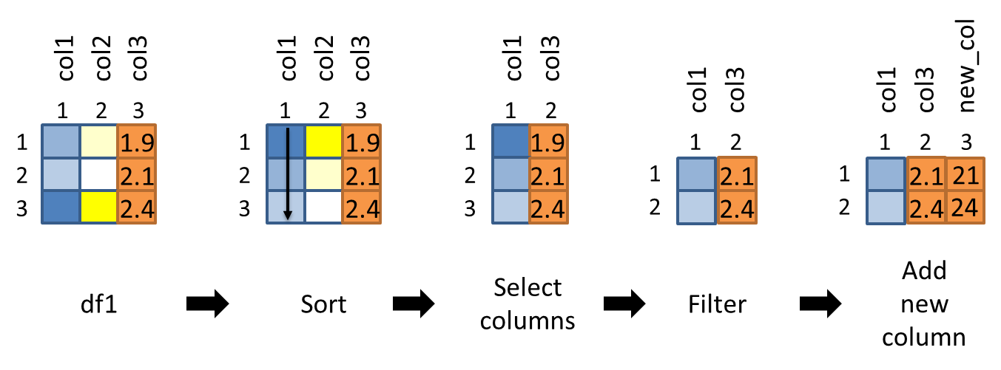
A typical workflow – base R
df1_sorted = df1[order(df1$col1), ]
df1_sel_vars = df1_sorted[, c(“col1”, “col3”)]
df1_filtered = df1_sel_vars[df1_sel_vars$col3 > 2.0, ]
df1_filtered$new_col = df1_filtered$col3 * 10
df1_sort_sel_filtered = df1[order(df1$col1), ][df1$col3 > 2.0, c(“col1”, “col3”)]
df1_sort_sel_filtered$new_col = df1_sort_sel_filtered$col3 * 10

Slide 6
A typical workflow – data.table
df1_sort_sel_filtered = df1[order(col1), ][
col3 > 2.0, .(col1, col3)][
, new_col := col3 * 10]
Install with install.packages(“data.table”)
We won’t discuss data.table in detail, except for some special functions (more from Irina later) but:
More intuitive for some people (similarity to base R)
Ultra-fast reading and writing and sorting (look up fread and fwrite – changed my life!)

Slide 7
A typical workflow – dplyr
df1 %>%
arrange(col1) %>%
select(col1, col3) %>%
filter(col3 > 2.0) %>%
mutate(new_col = col3 * 10) -> df_sort_sel_filtered
* Use spacing and indentation effectively to make your code readable

Slide 8
Dplyr is part of the ‘Tidyverse’
Tabular data structures - one observation per row, one variable per column
Simple functions that do one thing (filter, mutate, arrange, etc.)
Use the ‘pipe’ %>% to chain functions – imagine a flow of data from left to right
The Tidyverse package is a ‘meta-package’ consisting of
dplyr – data manipulation
ggplot2 – plotting (‘Grammar of Graphics’)
tidyr – functions to create ‘tidy data’
readr – reading and writing several file formats
purrr – expanded set of loop functions
tibble – tidy data.frames
stringr – handling strings (joining, searching, splitting, etc.)
forcats – handling categorical data (factors)

Slide 9
Arrange
df1_sorted = arrange(df1, col1)
arrange(df1, col1) -> df1_sorted
OR
OR
df1 %>%
arrange(col1) -> df1_sorted
df1_sorted = arrange(df1, col1, col2)
OR
df1 %>%
arrange(col1, col2) -> df1_sorted

Slide 10
Select columns
df1_selected = select(df1, col1, col3)
OR
df1 %>%
select(col1, col3) -> df1_selected
df1_selected = select(df1, -col2)
OR
df1 %>%
select(-col2) -> df1_selected

Slide 11
Filter
df1 %>%
filter(col3 > 2.0) -> df1_filtered
df1 %>%
filter(col2 < 100 & col3 > 2.0) -> df1_filtered
df1 %>%
filter(col2 < 100 | col3 > 2.0) -> df1_filtered

Slide 12
Mutate
df1 %>%
mutate(new_col = col3 * 2.0) -> df1_mutated
df1 %>%
mutate(new_col = col3 * 2.0) %>%
mutate(col4 = new_col/col3) -> df1_mutated
df1 %>%
mutate(new_col = col3 * 2.0, col4 = new_col/col3) -> df1_mutated

Slide 13
Base R vs Dplyr syntax
Column names in quotations in base R, but not in Dplyr
df1[, “col1”] # base R syntax
select(df1, col1) # dplyr syntax
Dplyr functions always have the data as the first argument
select(df1, col1)
arrange(df1, col1)
mutate(df1, col4 = col1 * 10)
When the ‘pipe’ %>% is used, the first argument of any function is passed invisibly, so we drop it in the actual function call
df1 %>% arrange(df1, col1) %>% select(<output_from_previous_step>, col1, col3)

Slide 14

Let’s explore practically

Slide 15
Summarise
Reduces multiple values to a single value
One column:
summarise(df1, sum(col1)) or summarise(df1, mean(col2))
Several columns:
summarise(df1, sum(col1), mean(col2), sd(col3))
Assign column names:
df1 %>%
summarise(sum_col1 = sum(col1), mean_col2 = mean(col2), sd_col3 = sd(col3)) -> df1_sum
Note: summarise()can be used separately, but typically used on grouped data created by group_by() - see next slides.

Slide 16
Useful functions for summarisation
Center: mean(), median()
Spread: sd(), IQR()
Range: min(), max(), quantile()
Position: first(), last()
Count: n(), n_distinct()
Logical: any(), all() ...

Slide 17
Group by one or more variables
df1 %>% group_by(col2)
Grouping itself doesn’t change how the data looks!
It means that further operations will always be performed “by group”.
df1 %>%
group_by(col2) %>%
summarise(sum_col4 = sum(col4)) -> df1_grouped
df1 %>%
group_by(col2, col3) %>%
summarise(sum_col4 = sum(col4)) -> df1_grouped
df1 %>%
group_by(new_col2 = toupper(col2)) %>%
summarise(sum_col4 = sum(col4)) -> df1_grouped

Slide 18
Explore it yourself
Scoped grouping - three scoped variants:
group_by_all(), group_by_if() and group_by_at() make it easy to group a dataset by a selection of variables.
across() - function, superseding the _all, _at, and _if versions of summarise() and mutate()
df1 %>%
group_by(col2, col3) %>%
summarise(across(c(col1, col4), mean)) -> df1_grouped

Slide 19

Real dataset
DOI: 10.1038/s41591-020-01194-5

Slide 20
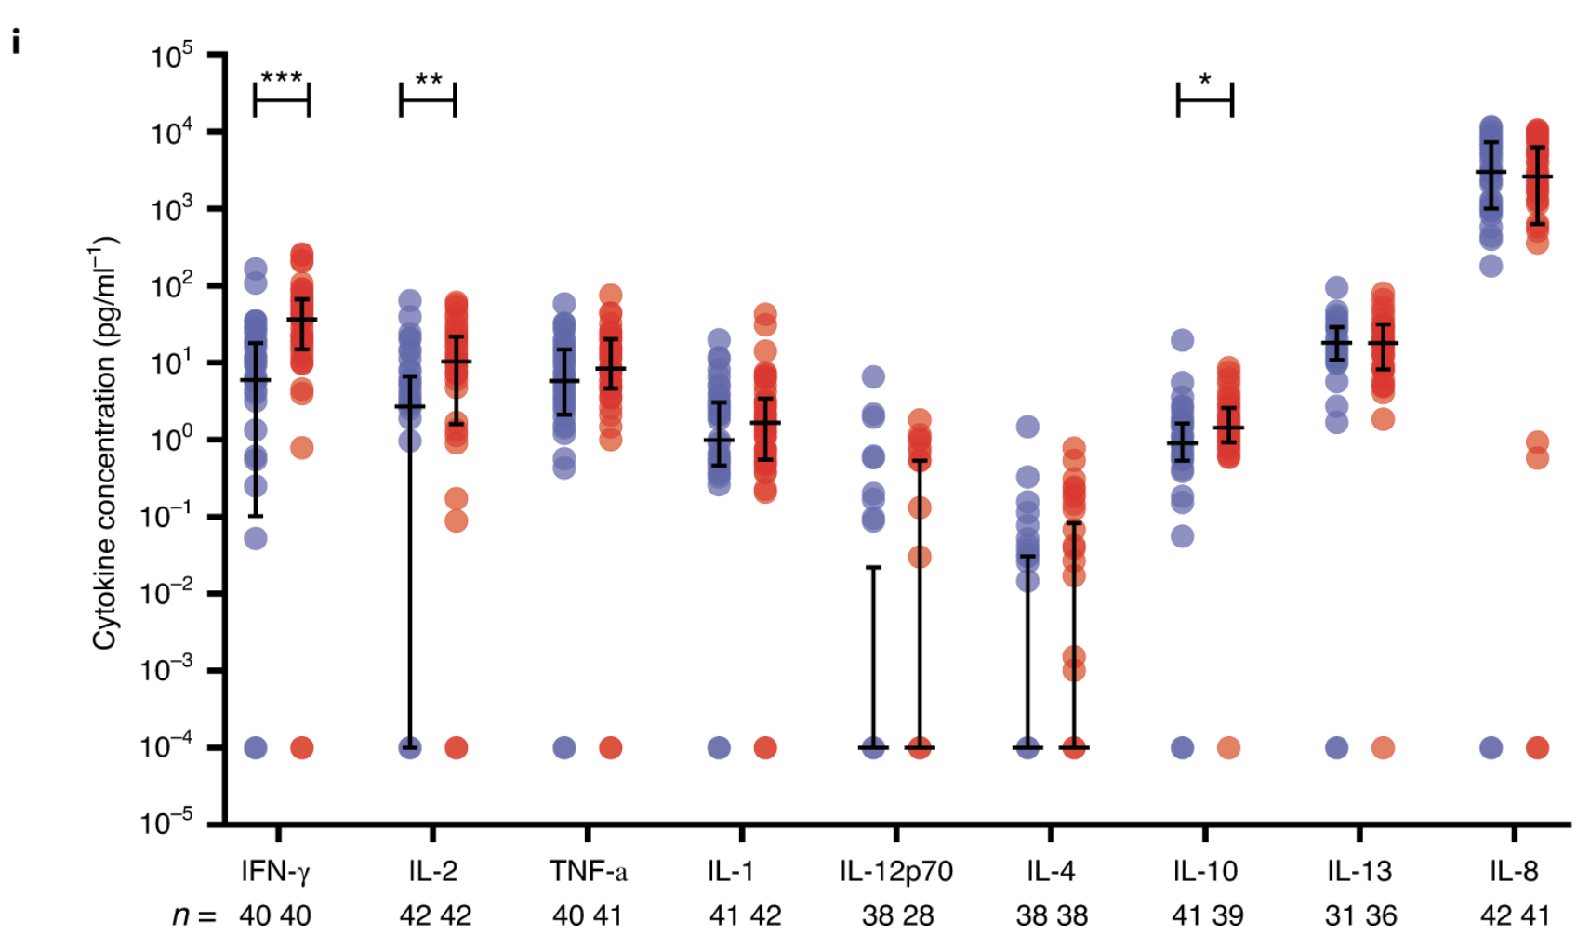
Data to explore - MSD
Fig.1
A multiplex cytokine analysis was performed on day 7 after vaccination using supernatants after antigen-specific stimulation of PBMCs from ChAdOx1 nCov-19 (red) and MenACWY (blue). Number of samples presented: MenACWY–ChAdOx1 nCov-19: IFN-γ (n = 40,40); IL-2 (n = 42,42); TNF-α (n = 40,41); IL-1β (n = 41,42); IL-12p70 (n = 38,28); IL-4 (n = 38,38); IL-10 (n = 41,39); IL-13 (n = 31,36); and IL-8 (n = 42,41). Individual data points are shown here as an aligned dot plot with lines showing the median with IQR. Significant differences were determined by two-tailed Mann–Whitney test with Bonferroni correction for multiple comparisons (***P < 0.001; **P < 0.01; *P < 0.05).

Slide 21
Let’s explore practically
Address the tasks in breakout rooms!

Slide 22
Loop functions
lapply() – perform an action on each element of a vector: returns list
sapply() – as above, returns a simplified object (variable)
apply() – loop over rows or columns of a matrix or df
tapply() – loop over a vector, split based on a factor
mapply() – loop over more than one vector
> my_list = list(a = c(1, 2, 3), b = c(4, 5, 6), c = c(7, 8, 9))
> lapply(my_list, mean)
$a
[1] 2
$b
[1] 5
$c
[1] 8

Slide 23
Assignment (use loop functions)

Slide 24
Useful reference
R Programming for Data Science (Roger Peng) – Ch. 3, 4, 5, 9
Swirl – Interactive learning
R for Data Science (Hadley Wickham) – Using Dplyr verbs
The data.table package – Intro
A data.table and Dplyr tour – Side by side comparison of functions
Cheatsheets – quick reference for tasks like data wrangling, visualisation, and several packages

